Slide 1

DIABETES PREDICTION
Using DATA SCIENCE & MACHINE LEARNING

Slide 2

INTRODUCTION :
Diabetes Mellitus (DM), commonly known as diabetes, is a group of metabolic disorders characterized by high blood sugar levels over a prolonged period. Diabetes is due to either the pancreas not producing enough insulin, or the cells of the body not responding properly to the insulin produced. There are three main types of diabetes mellitus:
Type 1 diabetes results from the pancreas's failure to produce enough insulin due to loss of beta cells. This form was previously referred to as "insulin-dependent diabetes mellitus" (IDDM) or "juvenile diabetes". The cause is unknown.
Type 2 diabetes begins with insulin resistance, a condition in which cells fail to respond to insulin properly. As the disease progresses, a lack of insulin may also develop. This form was previously referred to as "non insulin-dependent diabetes mellitus" (NIDDM) or "adult-onset diabetes". The most common cause is a combination of excessive body weight and insufficient exercise.
Gestational diabetes is the third main form, and occurs when pregnant women without a previous history of diabetes develop high blood sugar levels.
Prevention and treatment involve maintaining a healthy diet, regular physical exercise, a normal body weight, and avoiding use of tobacco. Control of blood pressure and maintaining proper foot care are important for people with the disease. Type 1 diabetes must be managed with insulin injections. Type 2 diabetes may be treated with medications with or without insulin. Insulin and some oral medications can cause low blood sugar. Weight loss surgery in those with obesity is sometimes an effective measure in those with type 2 diabetes. Gestational diabetes usually resolves after the birth of the baby.

Slide 3
Dataset Preparation
Data Description
When using machine learning algorithms we should always split our data into a training set and test set. (If the number of experiments we are running is large, then we can should be dividing our data into 3 parts, namely — training set, development set and test set). In our case, we will also separate out some data for manual cross checking.
The data set consists of record of 767 patients in total. To train our model we will be using 650 records. We will be using 100 records for testing, and the last 17 records to cross check our model.
We have our data saved in a CSV file called diabetes.csv. We first read our dataset into a pandas dataframe called data, and then use the head() function to show the first five records from our dataset.
Implementation
Training and Evaluating Machine Learning Model
Data Exploration
We can now train our classification model. We’ll be using a machine simple learning model called logistic regression. Since the model is readily available in sklearn, the training process is quite easy and we can do it in few lines of code. First, we create an instance called diabetesCheck and then use the fit function to train the model.
Let us now explore our data set to get a feel of what it looks like and get some insights about it.
Let’s start by finding correlation of every pair of features (and the outcome variable), and visualize the correlations using a heatmap.

Slide 4

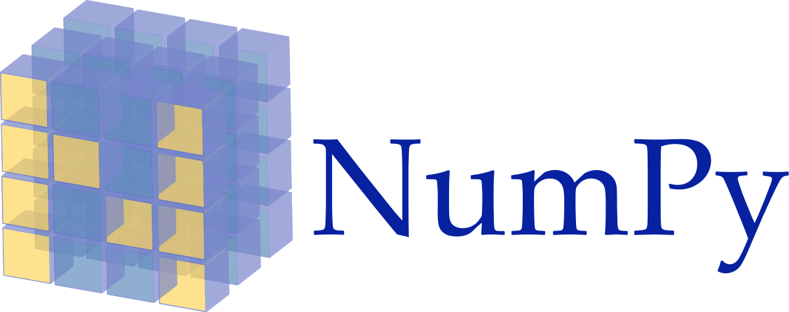





Used Libraries

Slide 5
PROJECT CONTENT:
01
Necessary Libraries.
02
Data Description.
03
Data Exploration & Prepration
04
Exploratory Data Analysis (EDA)
05
Data Preprocessing.
06
Data Modeling.
07
Data Evalution.

Slide 6
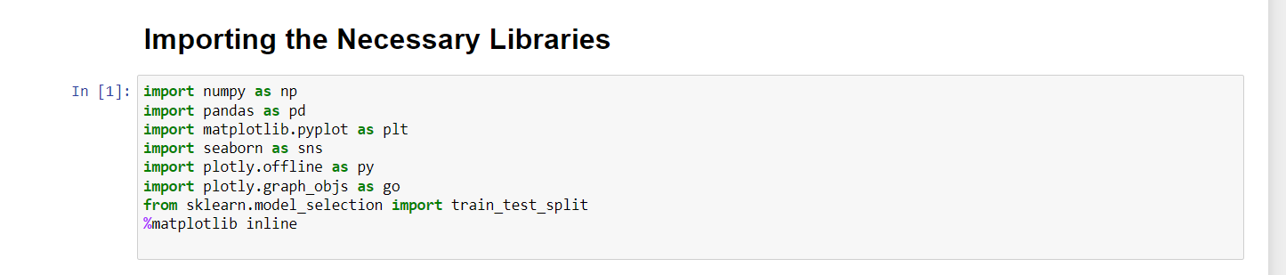
NECESSARY LIBRARIES.
01
A Python library is a collection of related modules. It contains bundles of code that can be used repeatedly in different programs. It makes Python Programming simpler and convenient for the programmer. As we don’t need to write the same code again and again for different programs

Slide 7
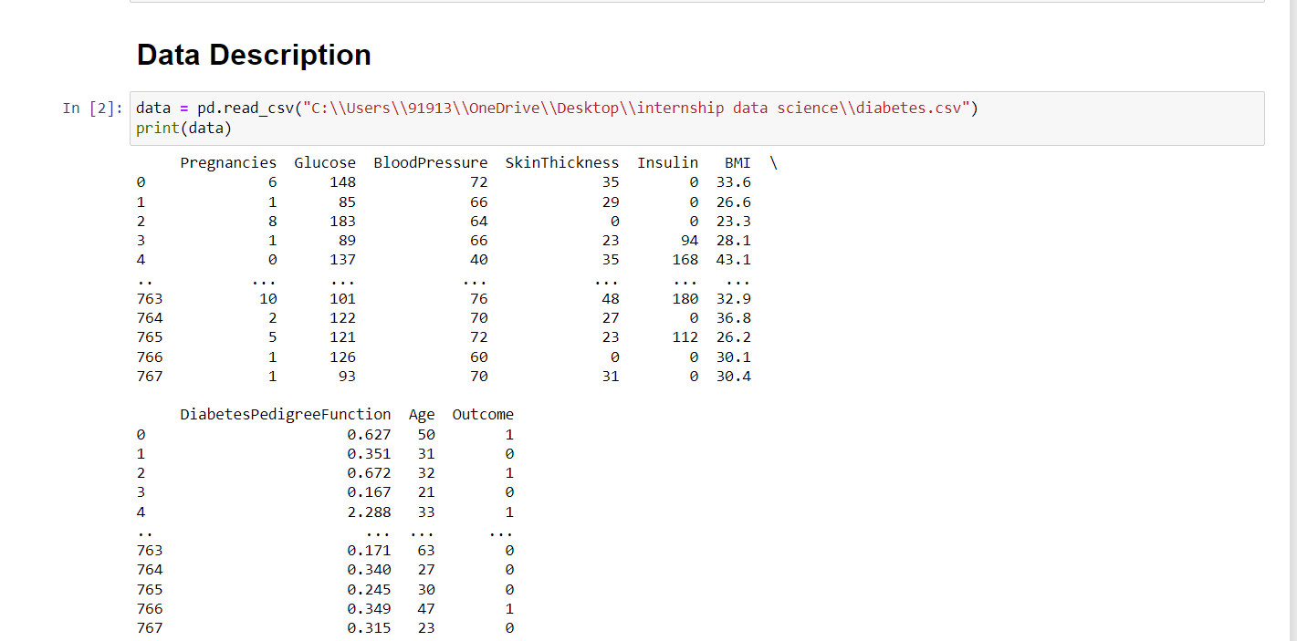
DATA DESCRIPTION
02
The description method is used for calculating some statistical data like percentile, mean and std of the numerical values of the Series or DataFrame. It analyzes both numeric and object series and also the DataFrame column sets of mixed data types.

Slide 8
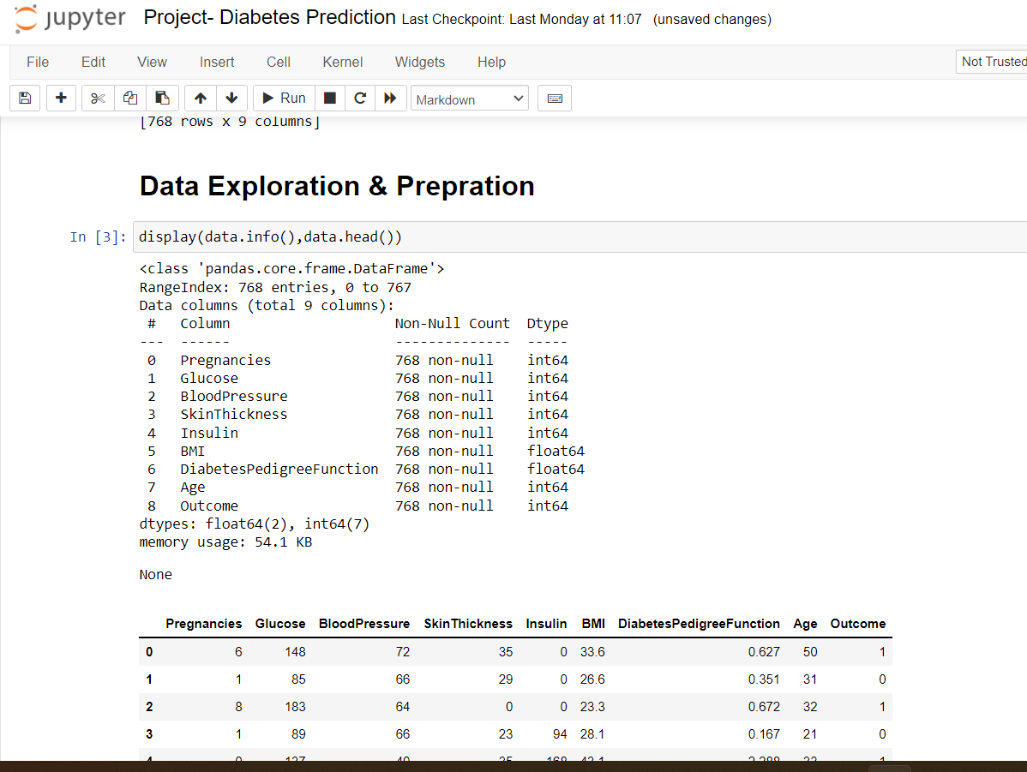
DATA EXPLORATION & PREPRATION
03
Data exploration is a key aspect of data analysis and model building. Without spending significant time on understanding the data and its patterns one cannot expect to build efficient predictive models. Data exploration takes major chunk of time in a data science project comprising of data cleaning and preprocessing.

Slide 9
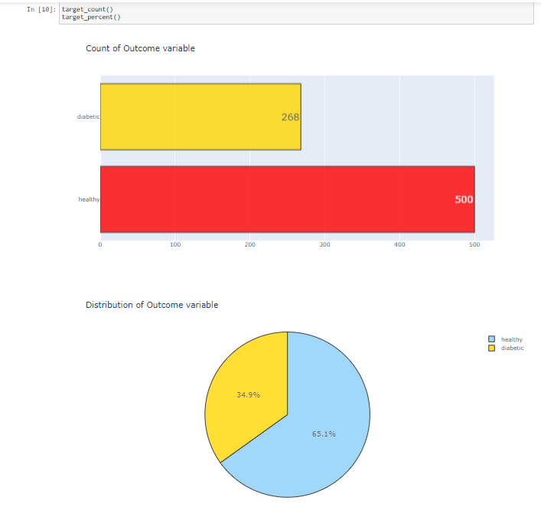
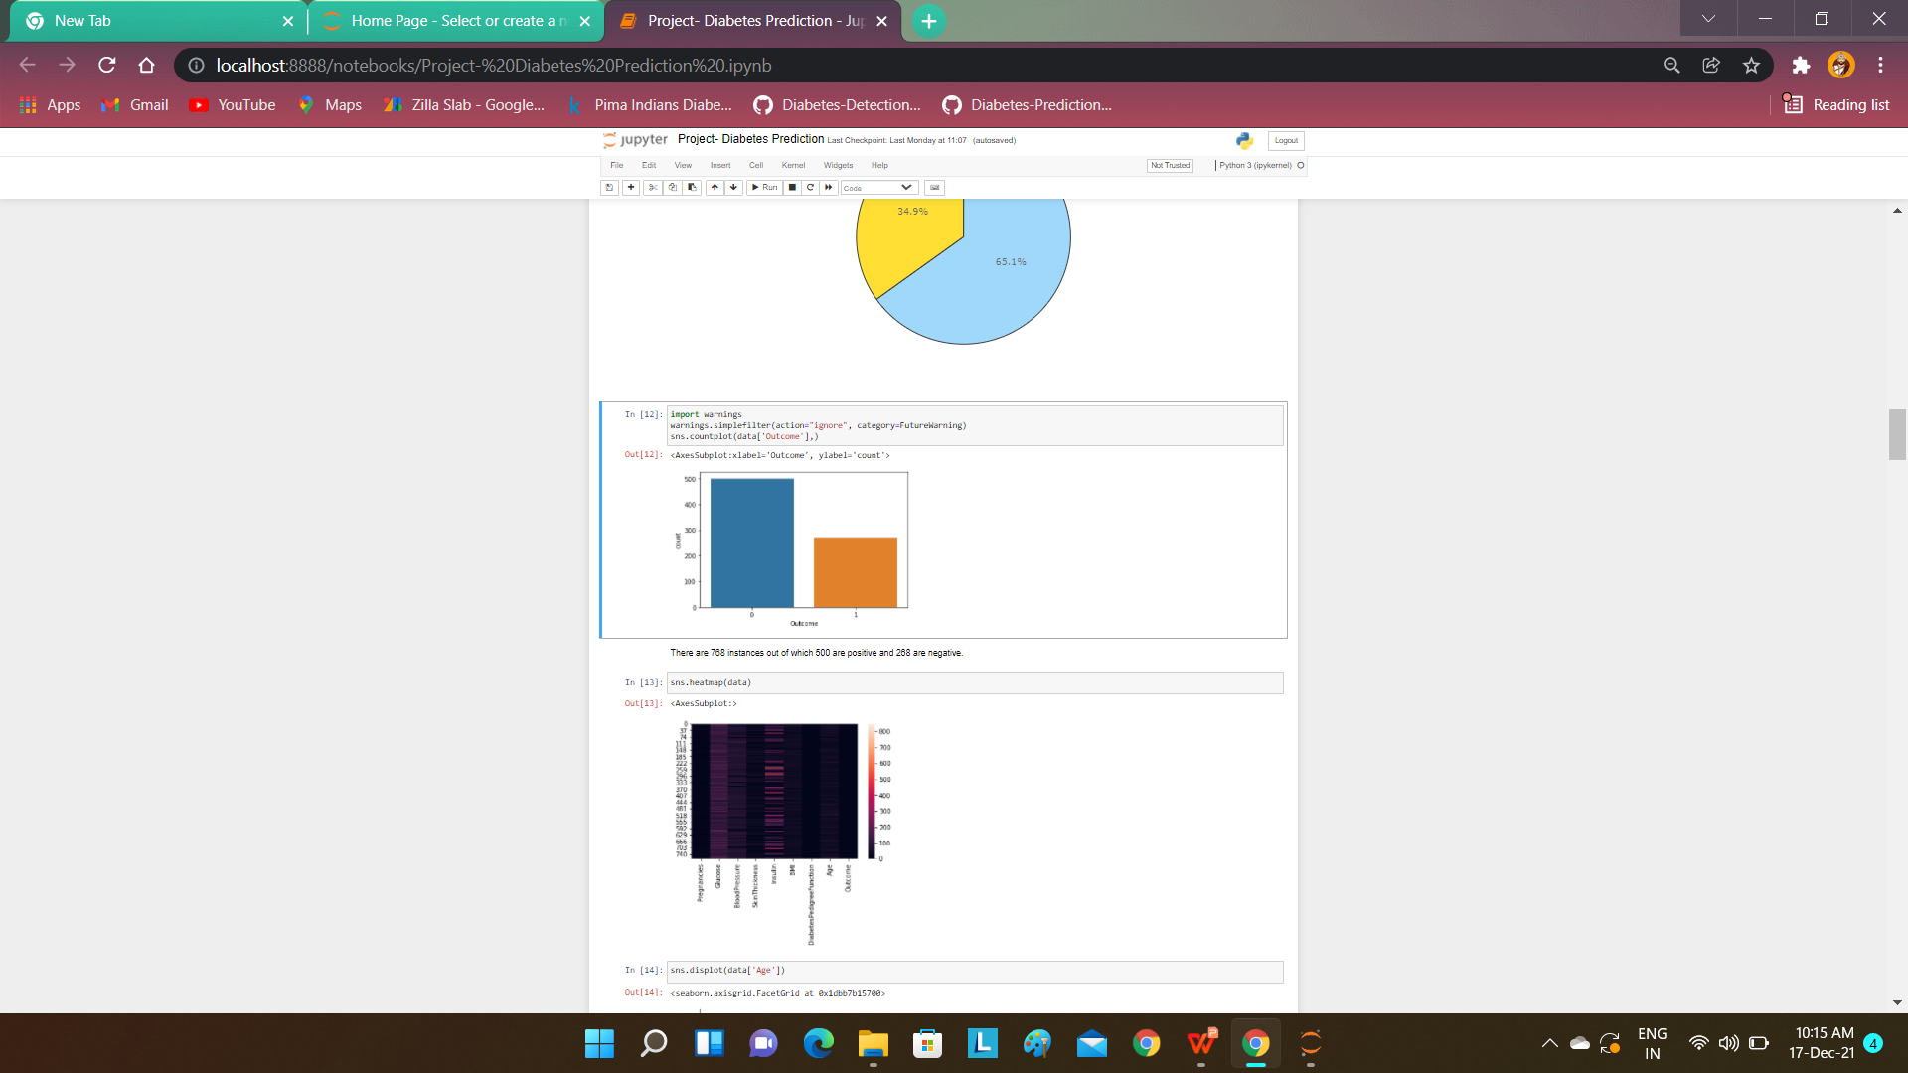
EXPLORATORY DATA ANALYSIS (EDA)
04
Exploratory data analysis is a complement to inferential statistics, which tends to be fairly rigid with rules and formulas. At an advanced level, EDA involves looking at and describing the data set from different angles and then summarizing it.

Slide 10
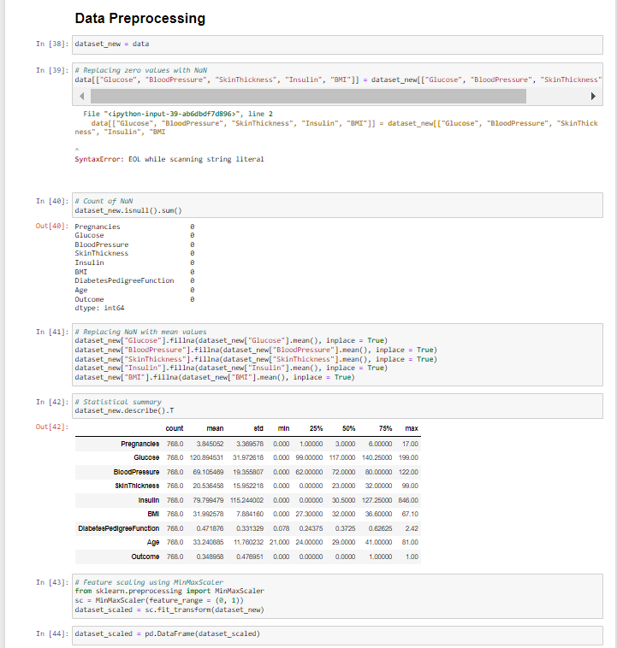
DATA PREPROCESSING
05
Data preprocessing is an integral step in Machine Learning as the quality of data and the useful information that can be derived from it directly affects the ability of our model to learn; therefore, it is extremely important that we preprocess our data before feeding it into our model.

Slide 11
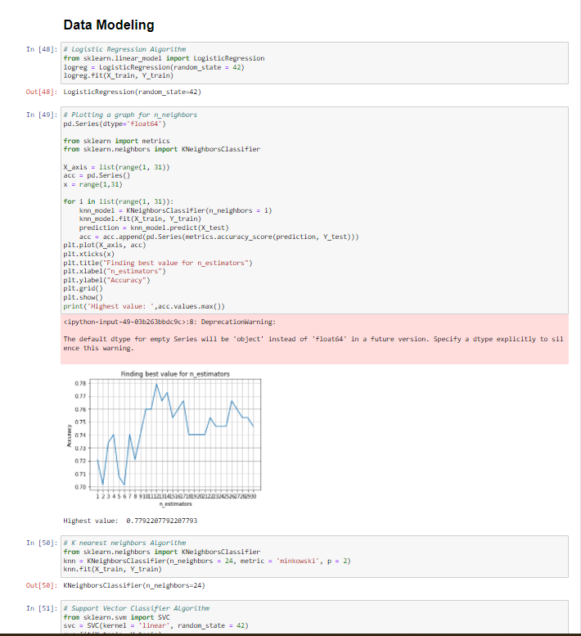
DATA MODELING
06
A datastore entity has a key and a set of properties. An application uses the datastore API to define data models, and create instances of those models to be stored as entities. Models provide a common structure to the entities created by the API, and can define rules for validating property values.

Slide 12
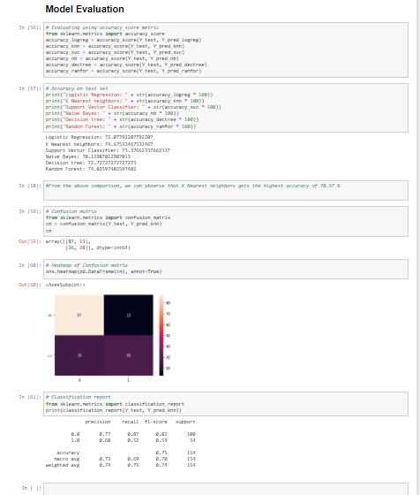
MODEL EVALUATION
07
Various model evaluation techniques help us to judge the performance of a model and also allows us to compare different models fitted on the same dataset. We not only evaluate the performance of the model on our train dataset but also on our test/unseen dataset.

Slide 13

Thank
You

